Slide 1


Sprint delivery
Sprint 2
Wednesday 8 June, 2022

Slide 2
Content
Sprint 2
Sprint 3
General - Software context
What is next?
General - Gitlab
Smartwatch - Pipeline & data collection
Dashboard - Start frontend
API - Technical document
API - Data Mediator
General - Legeility

Slide 3
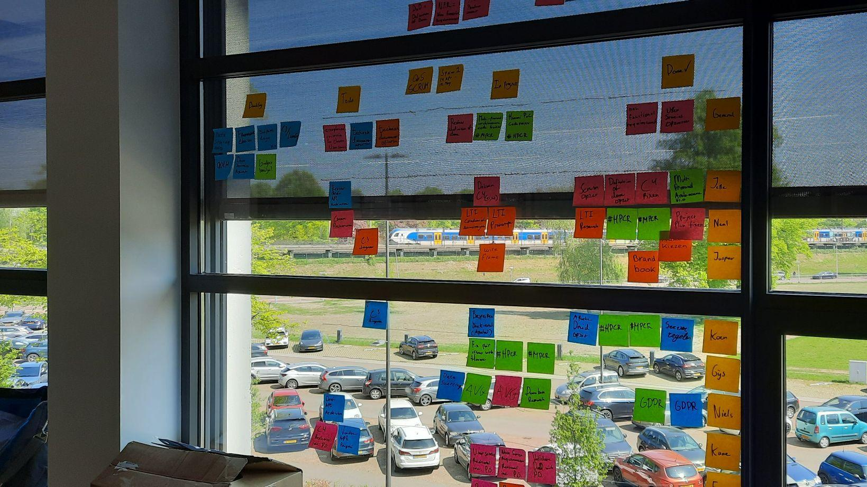
Sprint 2
“Prototyping Quantified student”
Notes:
The main mission for the first sprint

Slide 4
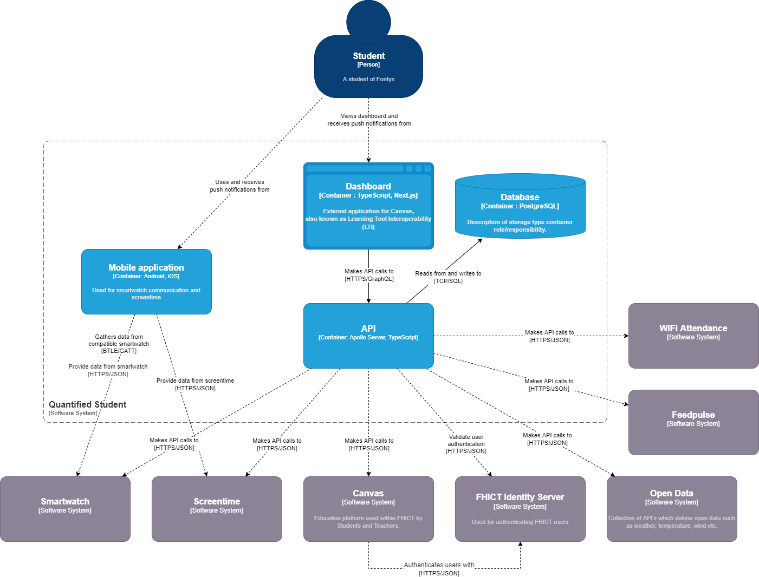
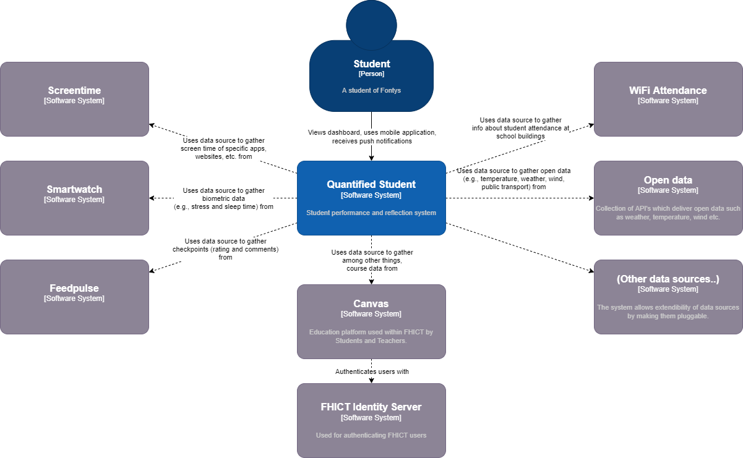
Deliverables - Software context
Context diagram
Data sources
Container diagram

Slide 5
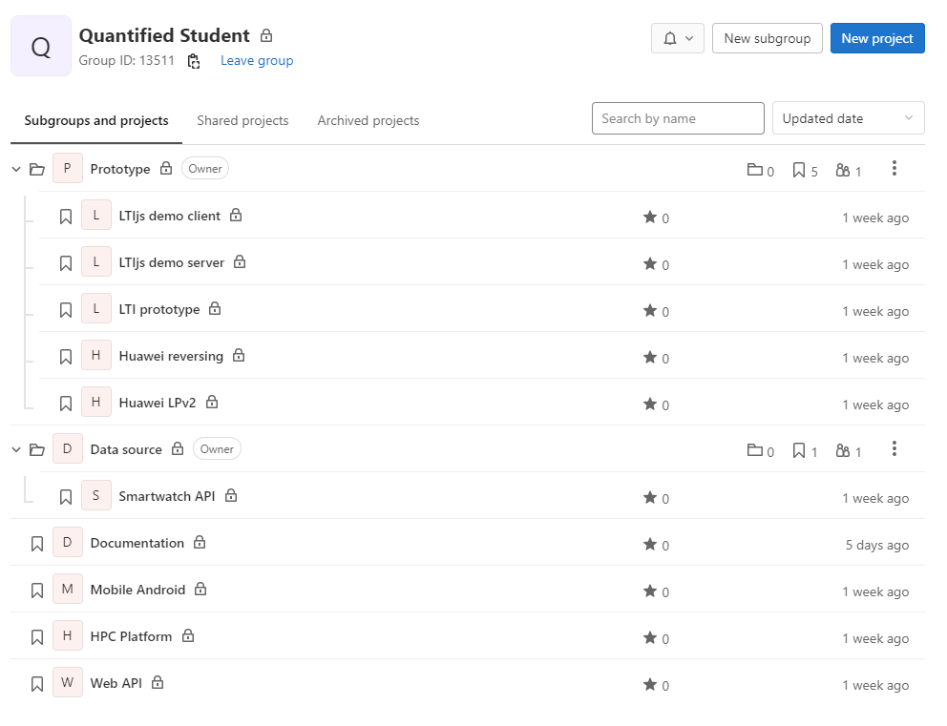
Deliverables - GitLab
Forks
Wiki
Documentatie

Slide 6
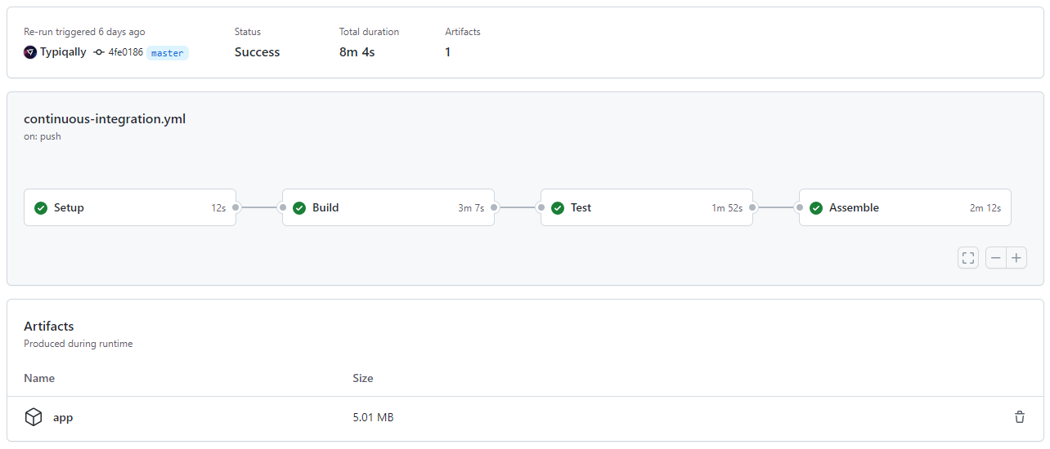
Deliverables - Smartwatch pipeline
GitHub actions
Building & testing
Artifacts

Slide 7
Deliverables - Smartwatch data collection
Pairing
Python
Android

Slide 8
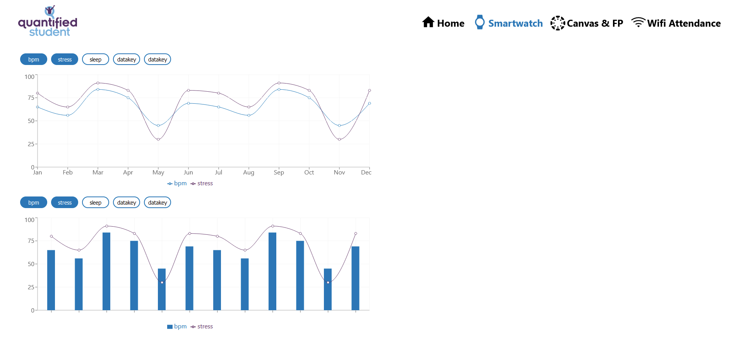
Deliverables - Start on the frontend
Notes:
I have created a first part of the frontend with a graph. The usage of the graph is to select multiple datakeys from the selected datasource so you can see the correlations between the two datakeys. Here you see two alternative ways to show the correlation between two datakeys. I will be expanding it with different types of graphs and by implementing the rest of the wireframe.

Slide 9

Deliverables - API Technical Document
System Architecture
Framework Decisions
Functionality
Notes:
The technical document for the API is in development and the main architecture decisions have been documented. Like which frameworks are to be used and what system functionality the API must adhere to. The latter still being in development.

Slide 10

Deliverables - Data Mediator
Available product analysis on different data mediator solutions
Requirement prioritization
Chose solutions based on multi-criteria decision matrix
Created prototype of the chosen solutions
Assessed best, good and bad practices

Slide 11


Legal
NDA
Data Protection Impact Analysis
Privacy agreement
ERD redesigns based of GDPR and AVG

Slide 12
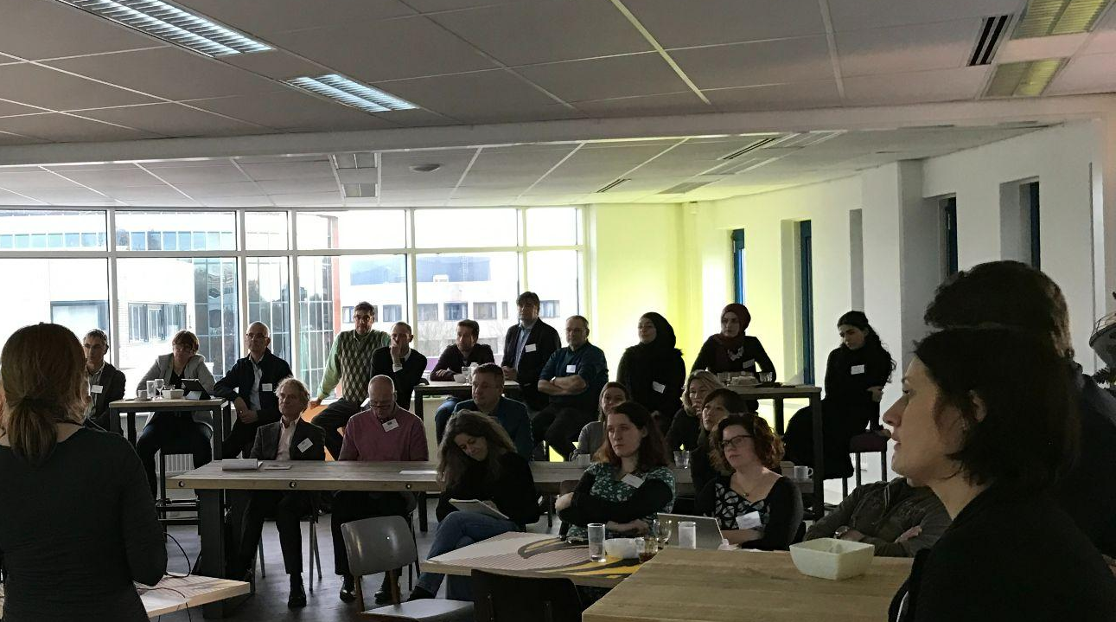
Next sprint.
Sprint 3

Slide 13
What is next?
The first beta versions
Beta V0.1 Dashboard
Beta V0.1 API
Technical document dashboard
Preparing for next semester
Transfer ownership document.

Slide 14
End of sprint delivery
Any questions?
Wednesday 8 June, 2022

